Slide 1



SQL
PROJECT AURELIUS

Slide 2




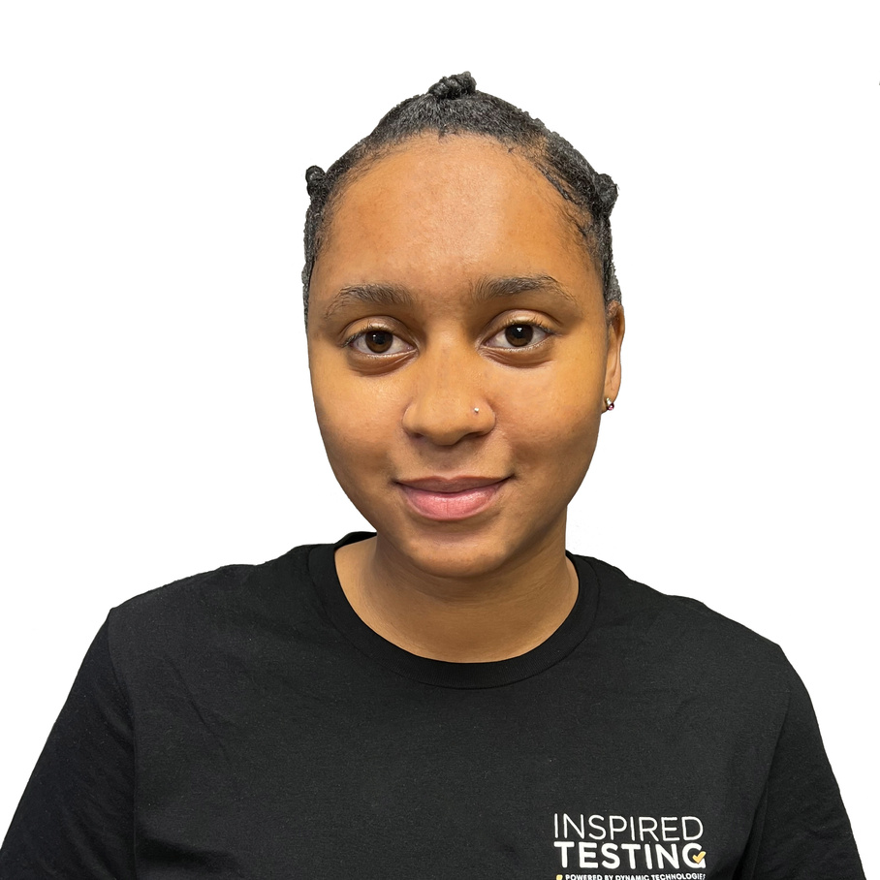




MEET THE TEAM
JODI LOUW
DIPHLO METSELENG
TENYEKO MAKAPANE
CONTRIBUTOR
CONTRIBUTOR
LEARNER

Slide 3


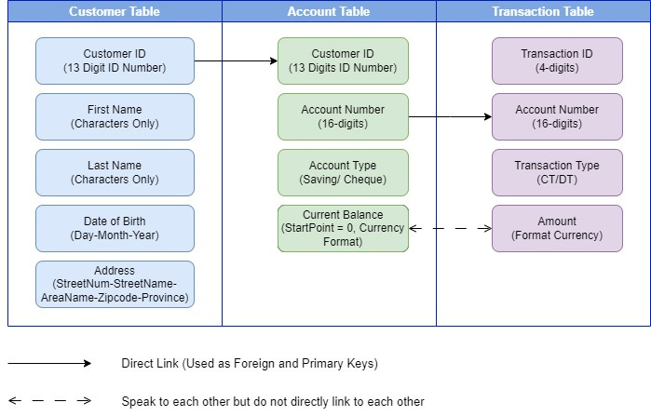

DATABASE STRUCTURE
3 Tables
13 Columns overall
3 Primary Keys
2 Foreign Keys
Address in the actual table has been split into 5 different tables for formatting and data validation purposes

Slide 4











MYSQL
Makes everything easier for you
Open Source, Compatible and Portable
Easy to download, use and administer the software
Available under GNU General Public License and has a large community of users and developers. It works with various operating systems, languages and platforms.
Database and Tables
Difficulties
MySQL is where we created our database and in that database we created the tables and columns needed to execute the functions.
He had difficulties when it come to updating the current balance. At first we had three different queries - a select, join and update. Once realizing we can join these queries together we adjusted the queries to one allowing it to work seamlessly

Slide 5





CONNECTING MYSQL TO JAVA
JDBC and Scanner
Difficulties
After creating our database in mySQL we moved on to IntelliJ to write our Java program. We used IntelliJ as it an integrated Java development environment and support testing through a Maven Project.
For the connection you need a mysql-connector-java dependency and a SQL connection String.
We added JDBC as a library in our IntelliJ.
Scanner was used to get the user’s input handling.
We added all the needed dependencies into the pom file in the Maven Project however I did not run a clean & install and therefore my dependencies were not working.
The SQL connection URL also served as a challenge, however if you knew the port and connection name it’s actually pretty easy

Slide 6








Java
Java Layout and Coding
Within our main fucntion we created a generateReports that would send the connection to the rest of the function that we had. Namely :
printAddress
printAccountBalance
printTransactions
Connection
To run the connection command, it needed to be placed inside a try and catch, if we didn’t want to use the catch we needed to add a throw SQLExecption at the end of our method declaration. Once connection is established we send SQL queries through to the database that then get executed and read it back into the program to be displayed.
Difficulties
Formulating the try and catch turned out to be more challenging then expected.
Database not found and Syntax errors.

Slide 7





How it works
Connection - The MySQL Clients send connection requests to the MySQL Server. A connection request is simply a TCP-IP connect message sent to port 3306 on the server host machine.
Receiver - Incoming connection requests are queued and then processed by the receiver thread one by one. The only job of the receiver thread is to create a user thread, further processing is done by the user thread.

Slide 8












TESTING AND REFINING
For the testing we used the JUnit framework.
We used it as:
Simple framework for writing automated, self-verifying tests in Java
Support for test assertions
Test suite development
Test Written
We wrote three different test cases. Each one matching that of the requirements provided to use. I will have one failed test case as we do not have an account that total of transaction equals 0.
Difficulties
Making the connection public for it to transfer across classes and to be used inside the test cases required additional support as we needed to create a new class for Database Connection Manager

Slide 9
THANK YOU

